Slide 1

Dr. Akbas
Joseph Alesandrini
Sarah Gleixner
Olivia Meholic
Troy Neubauer
Nicolas Rodriguez
Jeremiah Webb

Slide 2
A public website that will enable users to filter through a database of cybersecurity tools depending on their needs (commercial, personal, etc.) and generate a report summarizing all recommended tools
Overview

Slide 3

Team Member Roles
FrontEnd – Sarah, Olivia, Nicolas
Design
Login
Authentication
Filtering
BackEnd – Jeremiah, Troy, Joseph
Api
Filtering
AWS
Database

Slide 4
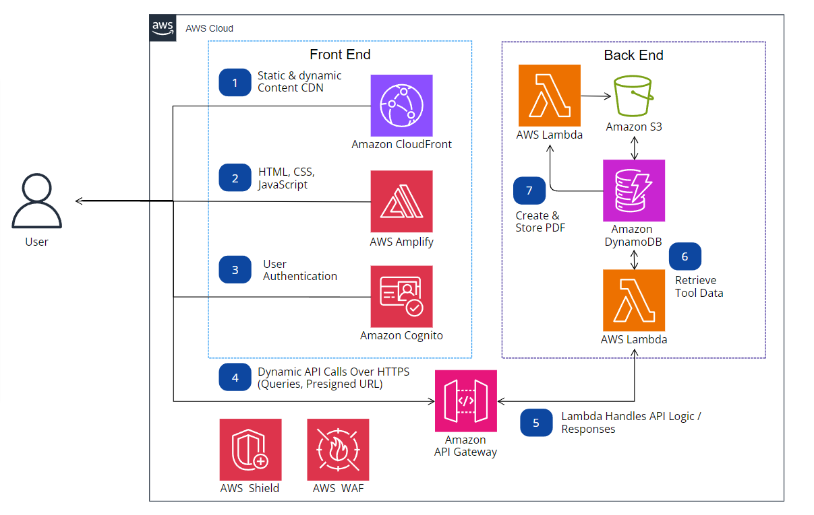
System Architecture
Frontend & backend flow
Roles/Objectives

Slide 5
Last Semester Progress
Account Information
Forgot Password with Authentication
Filtering
Continuous Integration

Slide 6
Current Status
Filtering
Upload Tools
Recommendation Algorithm
Tool Dashboard/Research
Research

Slide 7
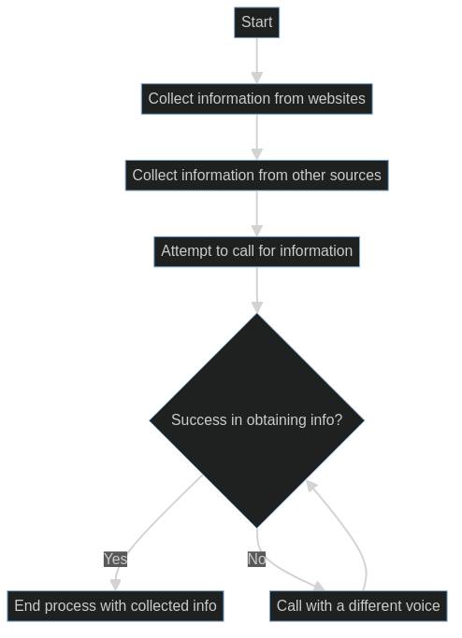
Collecting information
Positives
List has expanded
Informed research
Wide range of cybersecurity services
More Attributes
Negatives
Lacking aerospace specificity
Difficulty contacting companies

Slide 8
Research Updates
Current
Approved
Aviation specific
Cloud capable
Tool-box
Awards
Compliances
Phone
Devices
Documentation
Pricing
Requirements
Drawbacks
Original
AI use
Name
Customers
Keywords
Maturity
Website

Slide 9
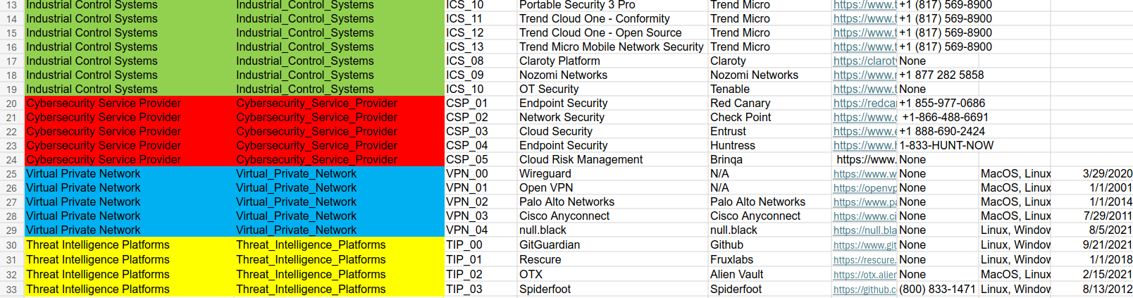
Database Expansion

Slide 10
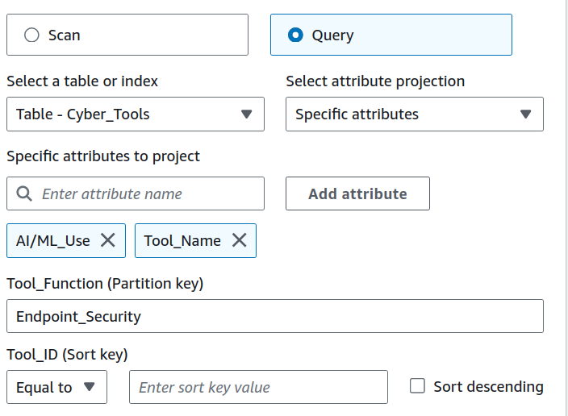
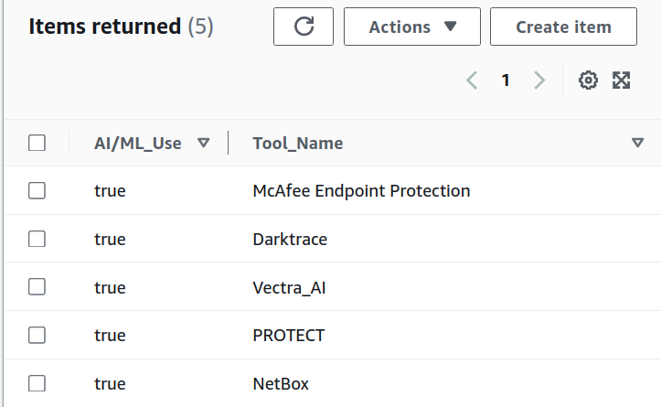
Tool Search Functionality

Slide 11
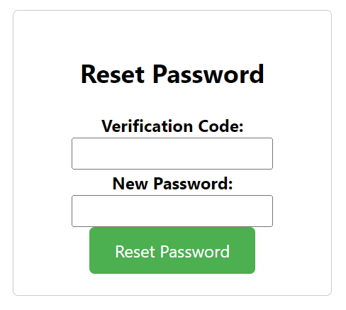
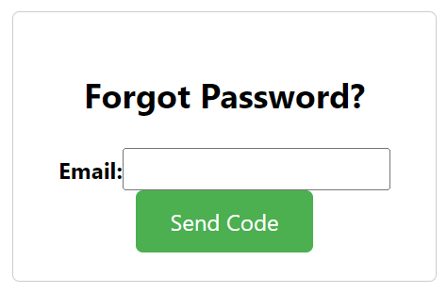


Account Functionality

Slide 12
Front end Filtering
Lambda Backend
Update Dashboard Table
User Input
Update JSON object
Uses checkboxes/dropdowns to filter user input
Depending on what the user choses, the JSON object is updated with the input as a string, int, bool, or array.
Once the user finishes choosing their filter options, they press a 'submit' button to send the JSON object to the backend function.
The dashboard table is updated accordingly.

Slide 13
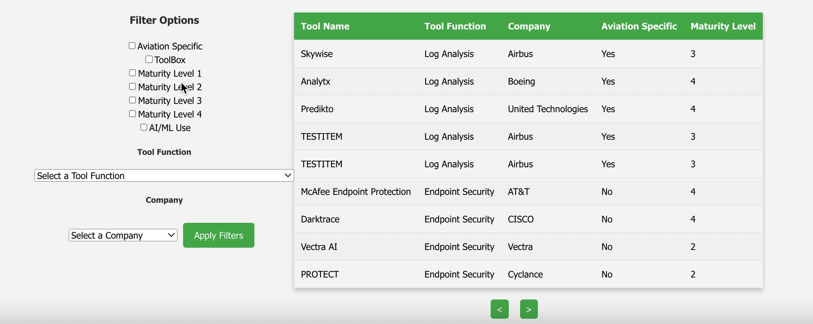
Filtering Demo

Slide 14

Upload Tool Demo

Slide 15
Pending Tool Dashboard Demo

Slide 16
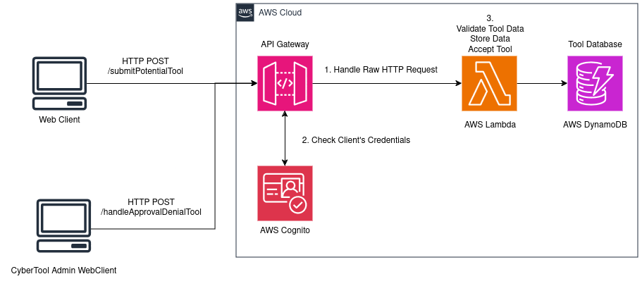
Pending/Upload Tool Architecture

Slide 17
Our Recommendation Approach
Matching multiple-choice survey questions to tools in database
Requires storing information with each tool that is directly related to a survey question
E.g. Storing cloud_capable for each tool
AI search

Slide 18
Why We Need AI Search
A multiple choice survey inherently loses the nuance of the user's requirements, and is like fitting a square peg into a round hole
A solution using natural language allows the user to communicate exactly what they want
Notes:
We found mutiple choice to be constraining

Slide 19
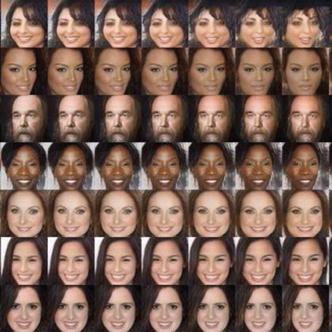
Background: Embedding Vectors
Transforming complex natural language into a higher dimensional space

Slide 20
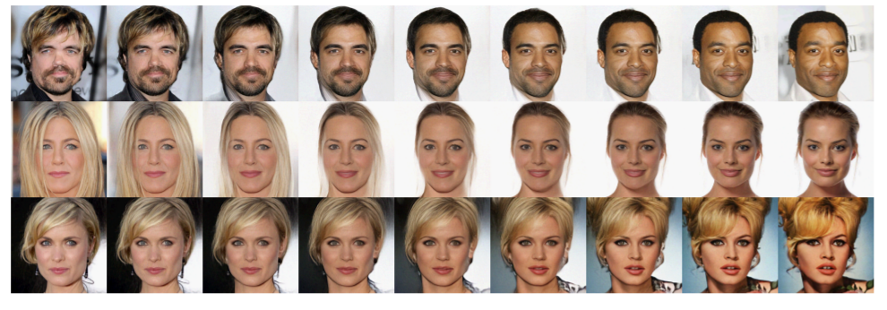
Higher Order Vector Space
Vector: [0.809, 0.250, 0.721, 0.197] N = 4
[0.0, X, X, …] [0.15, X, X, …] [0.45, X, X, …] [0.65, X, X, …] [0.85, X, X, …] [1.0, X, X, …]
[X, 0.0, X, …] [X, 0.15, X, …] [X, 0.45, X, …] [X, 0.65, X, …] [X, 0.85, X, …] [X, 1.0, X, …]
[X, X, 0.25, …] [X, X, 0.34, …] [X, X, 0.45, …] [X, X, 0.62, …] [X, X, 0.77, …] [X, X, 85, …]
Notes:
Each dimension of the vector represents a latent feature captured from the image/text, allowing the model to understand and compare faces mathematically

Slide 21
How Close Are Two Vectors?
The quick brown fox jumps over the lazy dog:
[0.034, 0.074, 0.056, 0.042, -0.018, 0.002, ...] N=384
The quick brown fox jumps over the lazy pig:
[0.068, 0.082, 0.052, 0.027, -0.022, 0.011, ...] N=384
Daytona Beach Wikipedia text:
[0.034, 0.011, 0.056, -0.013, 0.031, -0.002, ...] N=384
Notes:
Mention 4chan
LLAMA 2

Slide 22
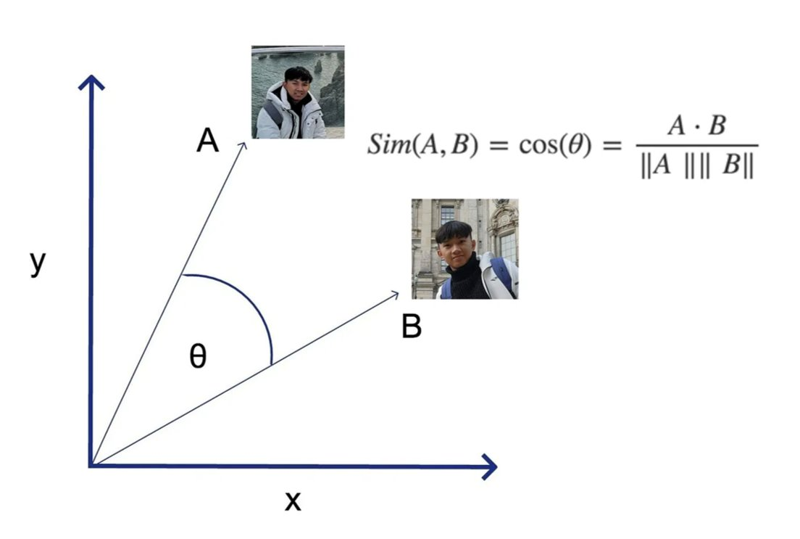
Finding Similarity in the Embedding Space

Slide 23
Risks or Issues
Speed Issues with loading Tool Dashboard – Python is SLOW
2 Seconds to load libraries, 250 ms to do function!

Slide 24
Goals for Next Sprint
Finish Lambda Function Documentation
Add more fields to Uploading Tool & Dashboard Filter
Convert Python Lambda Functions to Rust
CSS Cleanup for Website
Continue Tool Research
Finish PDF report generation

Slide 25
Live Demo

